Slide 1


Charge Entry

Slide 2

Charge Entry:
A process where you enter valid medical claim information and assign diagnosis codes, procedures codes, and modifiers before you file a medical insurance claim. Even one mistake could lead to a rejected or denied claim, resulting in thousands of dollars in lost revenue.

Slide 3

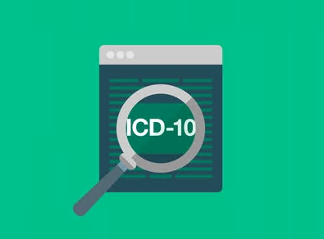

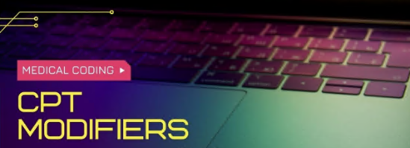
Coding Terminologies
ICD
CPT
Modifiers

Slide 4

ICD
International Classification of Disease ICD-10 is the 10th revision of the International Statistical Classification of Diseases and Related Health Problems (ICD), a medical classification list by the World Health Organization (WHO). It contains codes for diseases, signs and symptoms, abnormal findings, complaints, social circumstances, and external causes of injury or diseases

Slide 5

CPT
Current Procedural Terminology (CPT codes) are numbers assigned to every task and service a medical practitioner may provide to a patient including medical, surgical, and diagnostic services. They are used by insurers to determine the amount of reimbursement that a practitioner will receive by an insurer for that service.

Slide 6
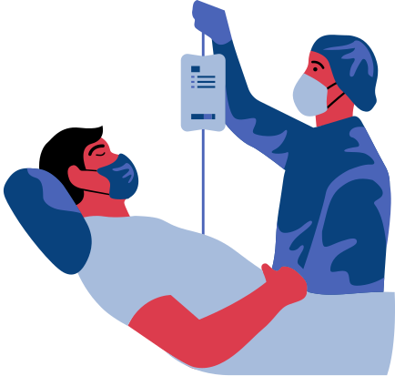
Modifiers
A CPT Modifier is a two-position alpha and alpha-numeric code used to identify certain situations that require the basic value of a procedure to be either enhanced or diminished. A modifier provides the means by which a service or procedure that has been performed can be altered without changing the procedures code.

Slide 7
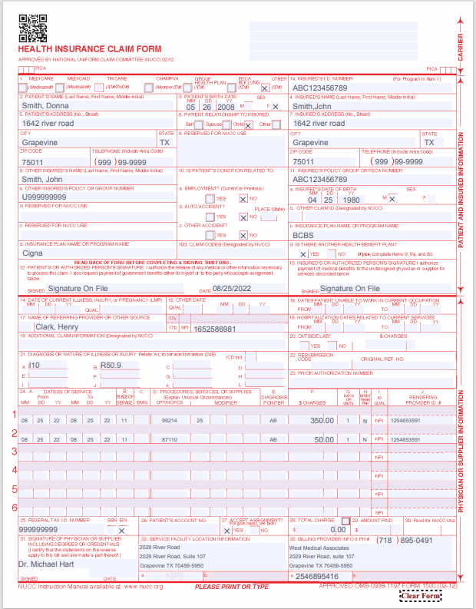
Charge Entry
Insurance Type
Insurance ID
Insured’s Name, Address, Contact
Charge Entry Info:
Patient Info/Insured Info.
DOS
POS
Diagnosis / DX / ICD Codes
CPT Codes
Modifiers
Insurance Information
Charge amount
Provider Information
NPI
Tax ID
Patient’s Name, Address, Contact
Primary Ins. ID
Secondary Ins. Info.
Primary Ins. Name
Referring Provider Name
Referring Provider NPI
ICD
Rendering Provider NPI
Date Of Service
Place Of Service
Units
Modifier
ICD Pointers
Amount
CPT Codes
Tax Identification Number
Billing Provider
Provider’s Sign and Date
08/30/2022
Billing NPI
Facility Address

Slide 8

Preclinical Stage
Presentations are communication tools that can be used as demonstrations, lectures, speeches, reports, and more.
Thank You

